Slide 1
AN ANDRIOD APPLICCATION FOR KEEPING UP THE LATEST HEADLINES

Slide 2
DESCRIPTION
Stay informed with Headlines Now, your go-to app for the latest news and updates! Get real-time access to breaking news, trending stories, and in-depth articles from trusted sources worldwide. Whether you're interested in politics, sports, technology, entertainment, or business, Headlines Now has it all, tailored to your preference.
Stay updated with Headlines Now! Get the latest breaking news, trending stories, and updates from trusted global and local sources. Customize your news feed, receive real-time alerts, and save articles for offline reading. Download now to stay informed, anytime, anywhere!
Get notified instantly about major stories.
Customize your feed to match your interests.
Share articles directly to your social media or with friends.

Slide 3
Main Activity.java:
package com.example.newsheadlines
import android.content.Context
import android.content.Intent
import android.content.Intent.FLAG_ACTIVITY_NEW_TASK
import android.os.Bundle
import android.util.Log
import android.widget.TextView
import androidx.activity.ComponentActivity
import androidx.activity.compose.setContent
import androidx.activity.viewModels
import androidx.compose.foundation.Image
import androidx.compose.foundation.background
import androidx.compose.foundation.clickable
import androidx.compose.foundation.layout.*
import androidx.compose.foundation.lazy.LazyColumn
import androidx.compose.foundation.lazy.itemsIndexed
import androidx.compose.foundation.selection.selectable
import androidx.compose.foundation.shape.RoundedCornerShape
import androidx.compose.material.Card
import androidx.compose.material.MaterialTheme
import androidx.compose.material.Surface
import androidx.compose.material.Text

Slide 4
import androidx.compose.runtime.*
import androidx.compose.ui.Modifier
import androidx.compose.ui.graphics.Color
import androidx.compose.ui.text.font.FontWeight
import androidx.compose.ui.text.style.TextAlign
import androidx.compose.ui.unit.dp
import androidx.compose.ui.unit.sp
import androidx.compose.ui.viewinterop.AndroidView
import androidx.core.text.HtmlCompat
import coil.compose.rememberImagePainter
import coil.size.Scale
import coil.transform.CircleCropTransformation
import com.example.example.Articles
import com.example.newsheadlines.ui.theme.NewsHeadlinesTheme
class MainPage : ComponentActivity() {
val mainViewModel by viewModels<MainViewModel>()
override fun onCreate(savedInstanceState: Bundle?) {
super.onCreate(savedInstanceState)
setContent {
NewsHeadlinesTheme {
// A surface container using the 'background' color from the theme
Surface(color = MaterialTheme.colors.background) {
Column() {

Slide 5
Text(text = "Latest NEWS", fontSize = 32.sp, modifier = Modifier.fillMaxWidth(), textAlign = TextAlign.Center)
MovieList(applicationContext, movieList = mainViewModel.movieListResponse)
mainViewModel.getMovieList()
}
}
}
}
}
}
@Composable
fun MovieList(context: Context, movieList: List<Articles>) {
var selectedIndex by remember { mutableStateOf(-1) }
LazyColumn {
itemsIndexed(items = movieList) {
index, item ->
MovieItem(context,movie = item, index, selectedIndex) { i ->
selectedIndex = i
}
}

Slide 6
}
}
@Composable
fun MovieItem(context: Context) {
val movie = Articles(
"Coco",
"",
" articl"
)
MovieItem(context,movie = movie, 0, 0) { i ->
Log.i("wertytest123abc", "MovieItem: "
+i)
}
}
@Composable
fun MovieItem(context: Context, movie: Articles, index: Int, selectedIndex: Int,
onClick: (Int) -> Unit)

Slide 7
{
val backgroundColor = if (index == selectedIndex) MaterialTheme.colors.primary else MaterialTheme.colors.background
Card(
modifier = Modifier
.padding(8.dp, 4.dp)
.fillMaxSize()
.selectable(true, true, null,
onClick = {
Log.i("test123abc", "MovieItem: $index/n$selectedIndex")
})
.clickable { onClick(index) }
.height(180.dp), shape = RoundedCornerShape(8.dp), elevation = 4.dp
) {
Surface(color = Color.White) {
Row(
Modifier
.padding(4.dp)
.fillMaxSize()
)

Slide 8
{
Image(
painter = rememberImagePainter(
data = movie.urlToImage,
builder = {
scale(Scale.FILL)
placeholder(R.drawable.placeholder)
transformations(CircleCropTransformation())
}
),
contentDescription = movie.description,
modifier = Modifier
.fillMaxHeight()
.weight(0.3f)
)
Column(
verticalArrangement = Arrangement.Center,
modifier = Modifier
.padding(4.dp)
.fillMaxHeight()
.weight(0.8f)
.background(Color.Gray)

Slide 9
.padding(20.dp)
.selectable(true, true, null,
onClick = {
Log.i("test123abc", "MovieItem: $index/n${movie.description}")
context.startActivity(
Intent(context, DisplayNews::class.java)
.setFlags(Intent.FLAG_ACTIVITY_NEW_TASK)
.putExtra("desk", movie.description.toString())
.putExtra("urlToImage", movie.urlToImage)
.putExtra("title", movie.title)
)
})
) {
Text(
text = movie.title.toString(),
style = MaterialTheme.typography.subtitle1,
fontWeight = FontWeight.Bold
)
HtmlText(html = movie.description.toString())
}
}
}

Slide 10
}
@Composable
fun HtmlText(html: String, modifier: Modifier = Modifier) {
AndroidView(
modifier = modifier
.fillMaxSize()
.size(33.dp),
factory = { context -> TextView(context) },
update = { it.text = HtmlCompat.fromHtml(html, HtmlCompat.FROM_HTML_MODE_COMPACT) }
)
}
}

Slide 11
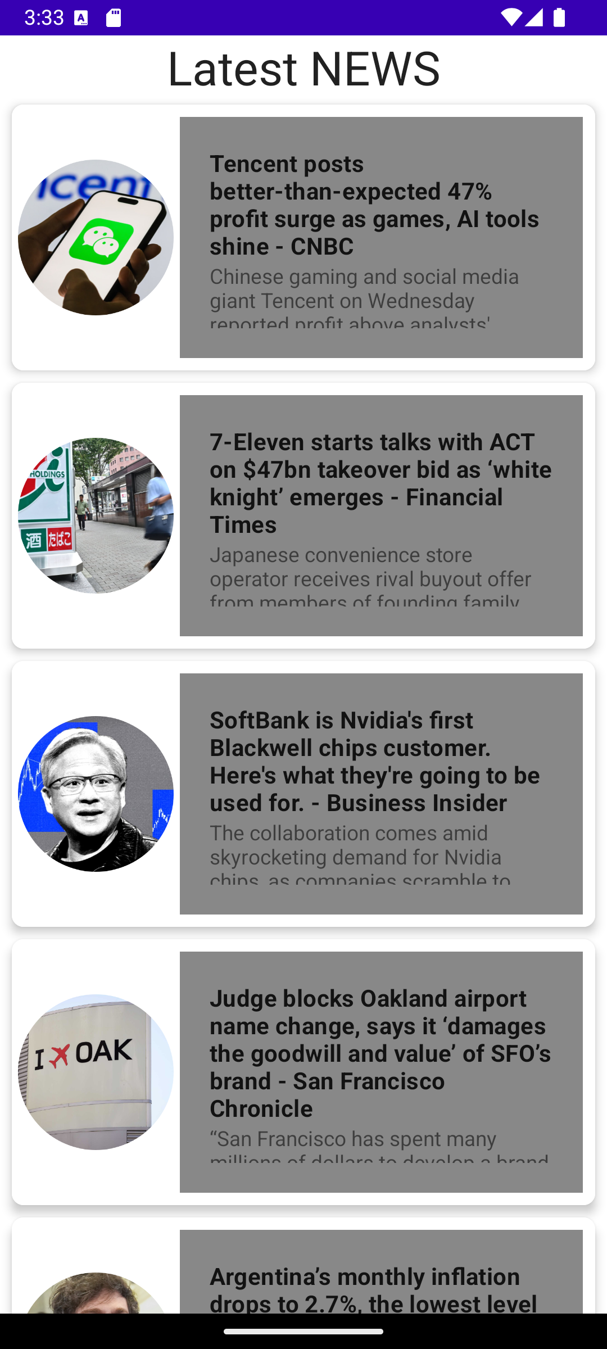

Slide 12
